Slide 1

Network Intrusion Detection System for Imbalanced Dataset
JINCY JOSE S3 B ROLL NO : 3

Slide 2
INTRODUCTION
Imbalanced data refers to those types of datasets where the target class has an uneven distribution of observations, i.e one class label has a very high number of observations and the other has a very low number of observations.
Network Intrusion Detection Systems must effectively identify security threats and protect the applications. The focus of the paper is the presence of class imbalance problem in intrusion datasets.

Slide 3
Relevance of Topic
This problem is predominant in scenarios where anomaly detection is crucial like electricity pilferage, fraudulent transactions in banks, identification of rare diseases, etc. In this situation, the predictive model developed using conventional machine learning algorithms could be biased and inaccurate.
This happens because Machine Learning Algorithms are usually designed to improve accuracy by reducing the error. Thus, they do not take into account the class distribution / proportion or balance of classes.

Slide 4
This guide describes various approaches for solving such class imbalance problems using various sampling techniques. We also weigh each technique for its pros and cons. Finally, I reveal an approach using which you can create a balanced class distribution and apply ensemble learning technique designed especially for this purpose.

Slide 5
Description Of Project
To build the imbalanced dataset, the problem regarding its prediction, and how to deal with such data more efficiently than the traditional approach.
To try different models and come up with the best possible model for imbalanced dataset and validation.

Slide 6

Proposed System
Our proposed approach class imbalance reduction is based on calculating the centroid of all attributes of minority class samples for synthesizing new samples. Our approach SMOTE technique are used.
The focus of the paper is the presence of class imbalance problem in intrusion datasets.An effient intrusion detection system must accurately identify all threats even if they form a small fraction of the intrusion data.

Slide 7
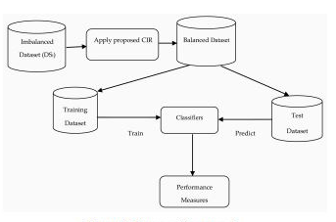
Proposed Architecture

Slide 8
Datasets used
The suitable dataset was found & downloaded from https://www.kaggle.com website.The dataset is "KDD-99".The dataset contain a total of 24 training attack types,with an additional 14 types in the test datas.

Slide 9
Approach to handling Imbalanced Data
Choose Proper Evaluation Metric
Resampling (Oversampling and Undersampling)
SMOTE(Synthetic Minority Oversampling Technique)
Build Random forest classifiers

Slide 10
References
[1]
https://www.sciencedirect.com/science/article/abs/pii/S0957417421017243
[2]
https://www.analyticsvidhya.com/blog/2021/06/5-techniques-to-handle-imbalanced-data-for-a-classification-problem/
[3]
Jhttps://www.researchgate.net/publication/228084509_Handling_imbalanced_datasets_A_review

Slide 11
Thank You

